Slide 1
IoT BOTNET ATTACK DETECTION SYSTEM
SARIM AMIR
GUFRAN BHATTI
ABDULBARI

Slide 2
ALGORITHM USE IN THIS PROJECT
CNN
SVM
DECISION TREE
NAÏVE BAYES

Slide 3
CNN
Using pandas library we will read our dataset (Iot botnet) from directory
After reading the dataset we start Feature engineering on our dataset
Now our dataset is ready for training
After training dataset our model is ready to predict

Slide 4
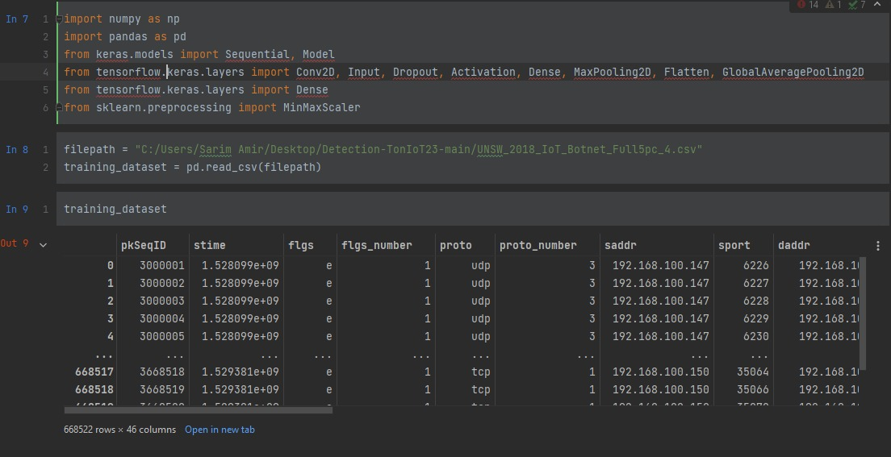

Slide 5
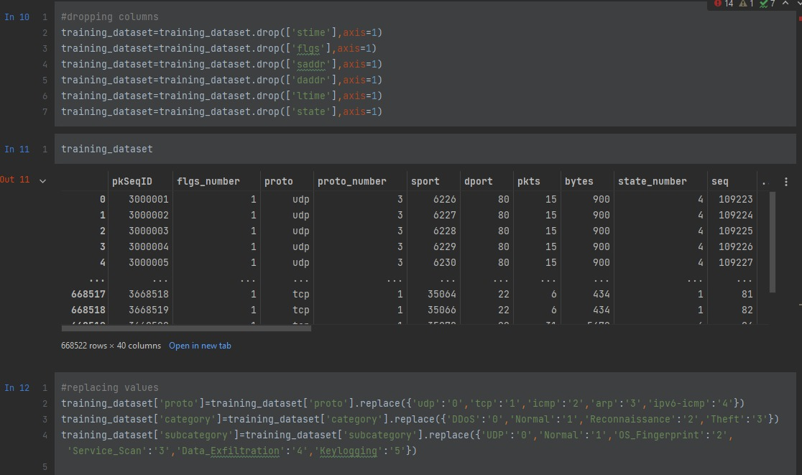

Slide 6
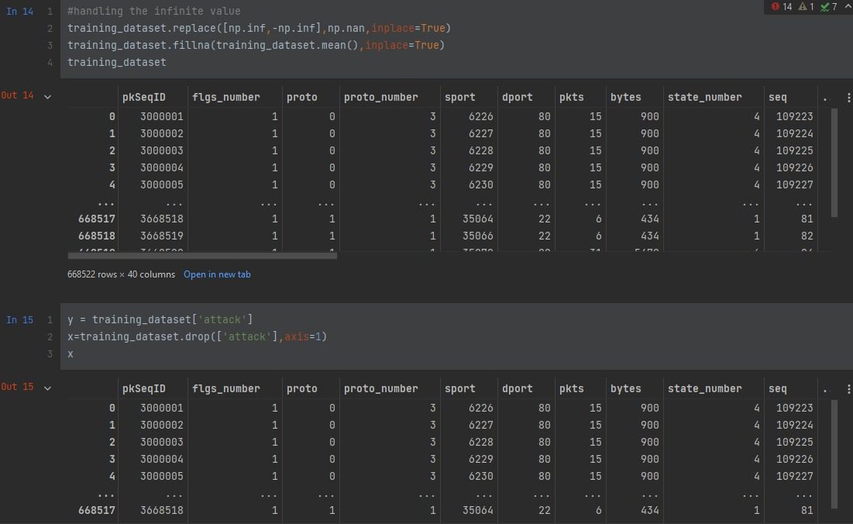

Slide 7
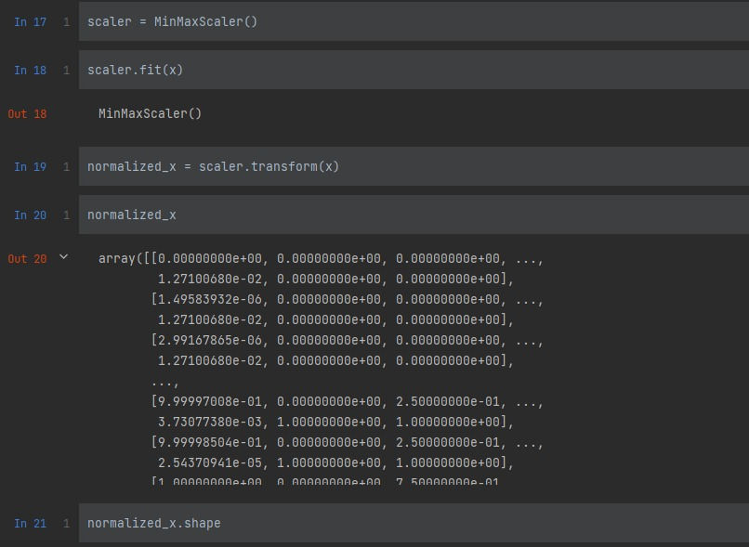

Slide 8
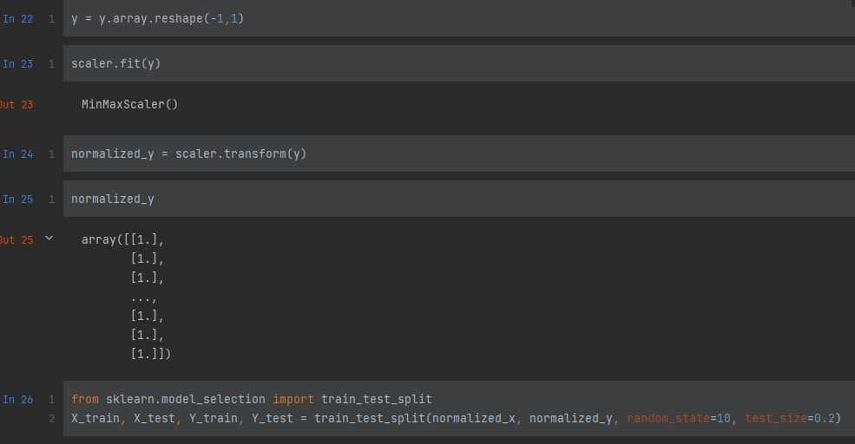

Slide 9
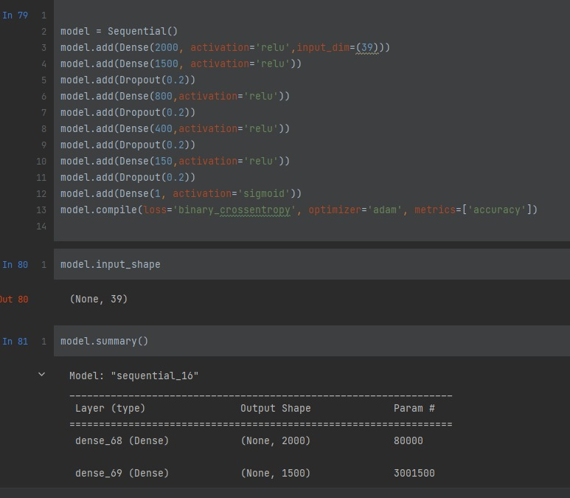

Slide 10
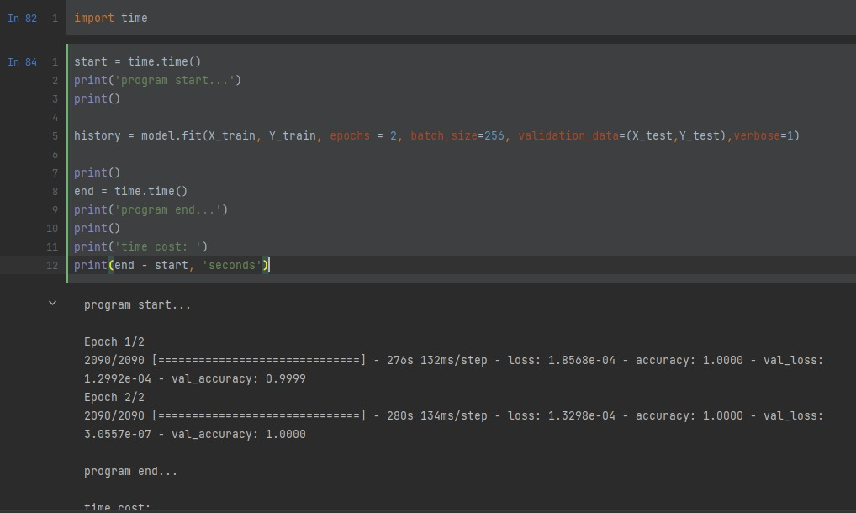

Slide 11
NAÏVE BAYES
Using pandas library we will read our dataset (Iot botnet) from directory
After reading the dataset we start Feature engineering on our dataset
Now our dataset is ready for training
After training dataset our model is ready to predict

Slide 12
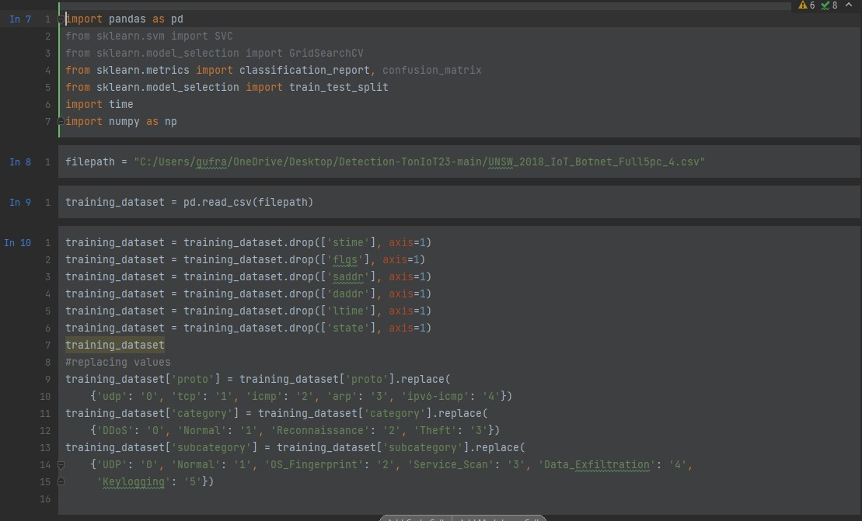

Slide 13
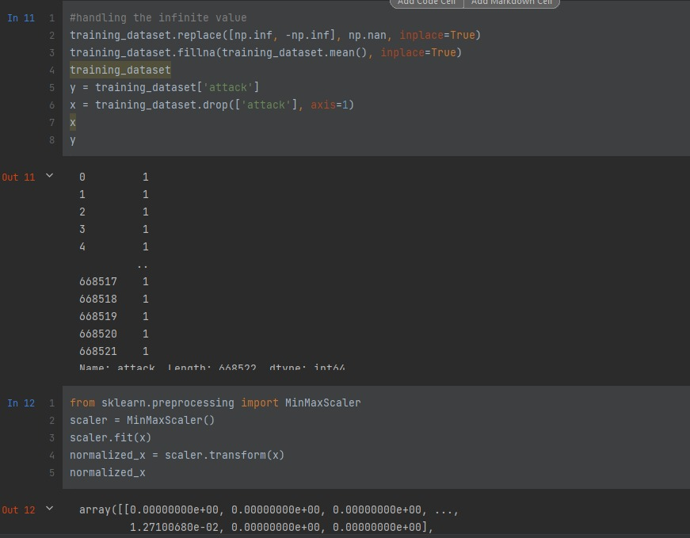

Slide 14
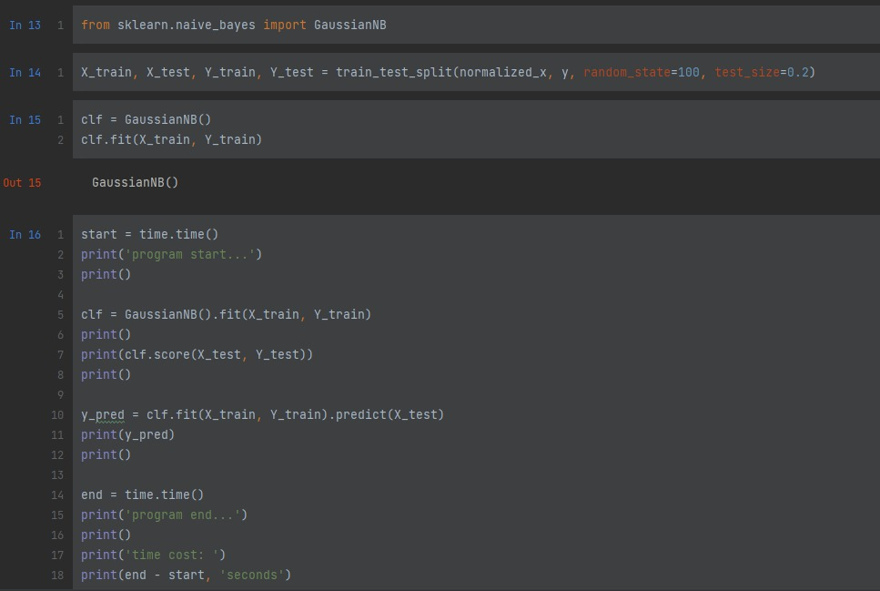

Slide 15
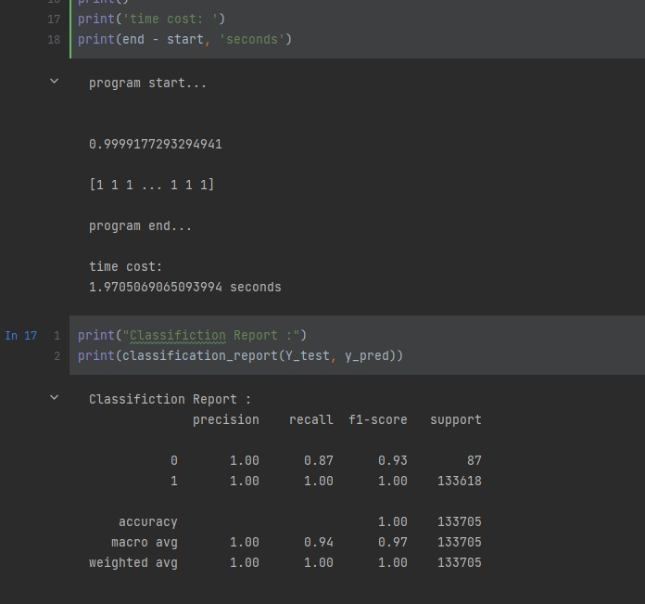

Slide 16
DECISION TREE
Using pandas library we will read our dataset (Iot botnet) from directory
After reading the dataset we start Feature engineering on our dataset
Now our dataset is ready for training
After training dataset our model is ready to predict

Slide 17
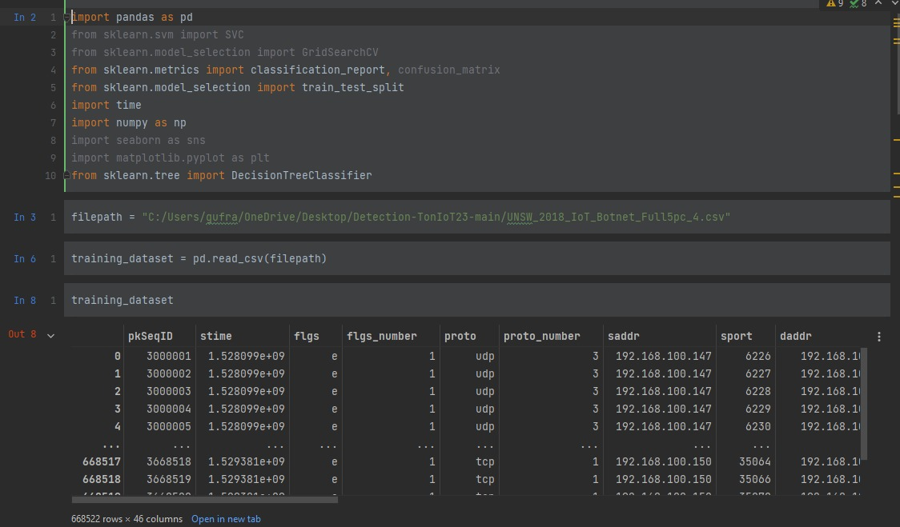

Slide 18
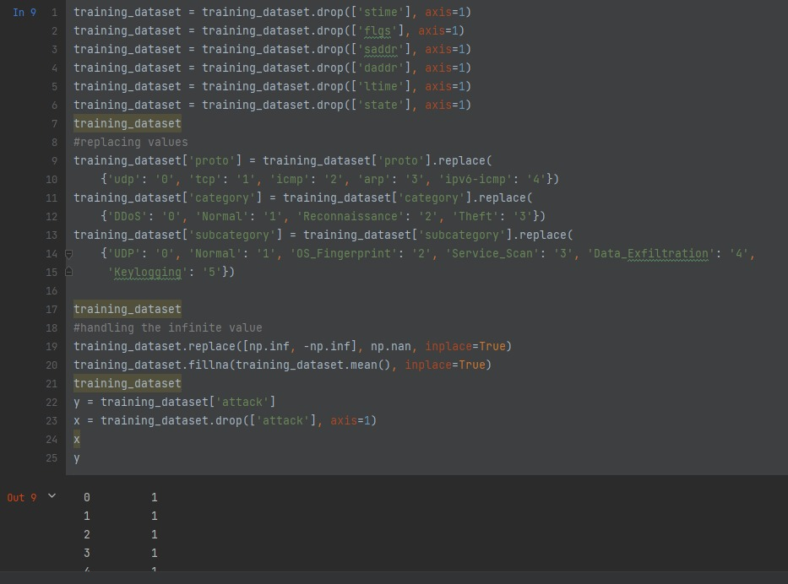

Slide 19
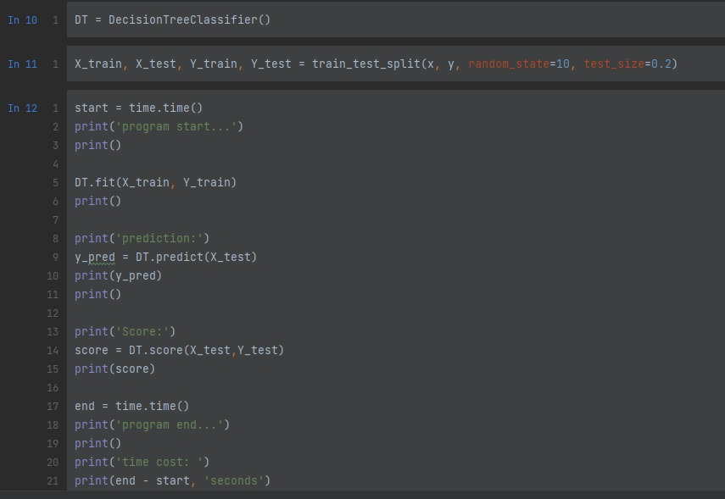

Slide 20
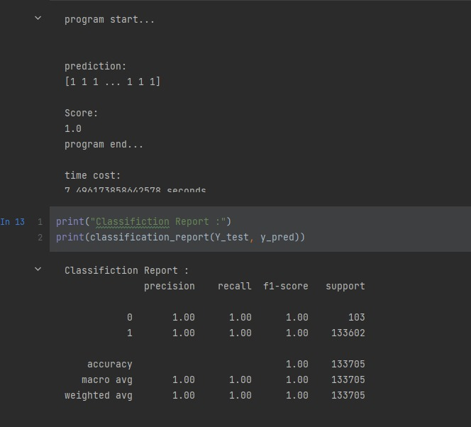

Slide 21
SVM
Using pandas library we will read our dataset (Iot botnet) from directory
After reading the dataset we start Feature engineering on our dataset
Now our dataset is ready for training
After training dataset our model is ready to predict

Slide 22
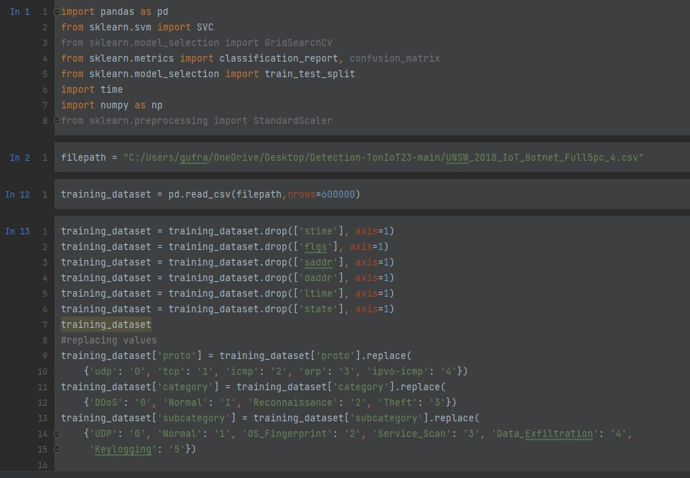

Slide 23
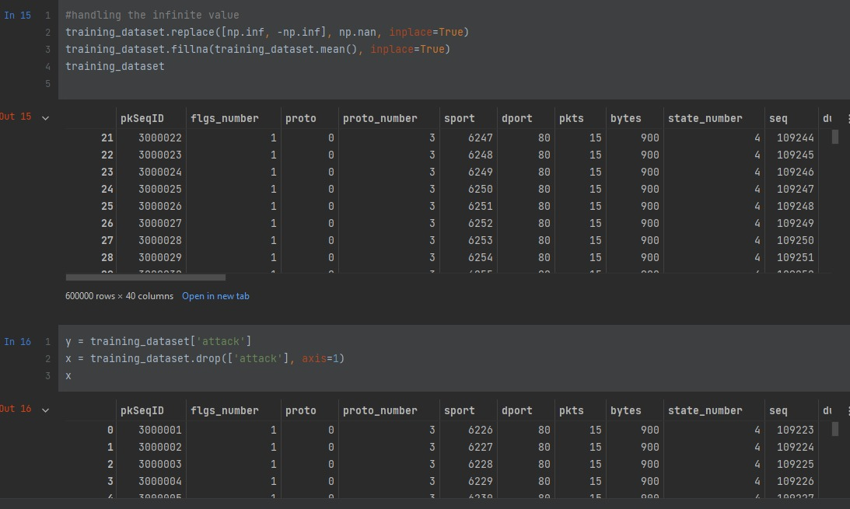

Slide 24
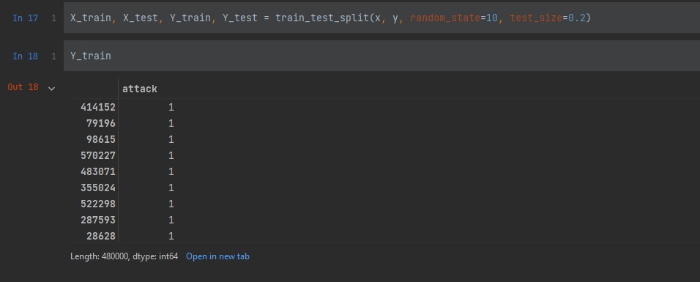

Slide 25
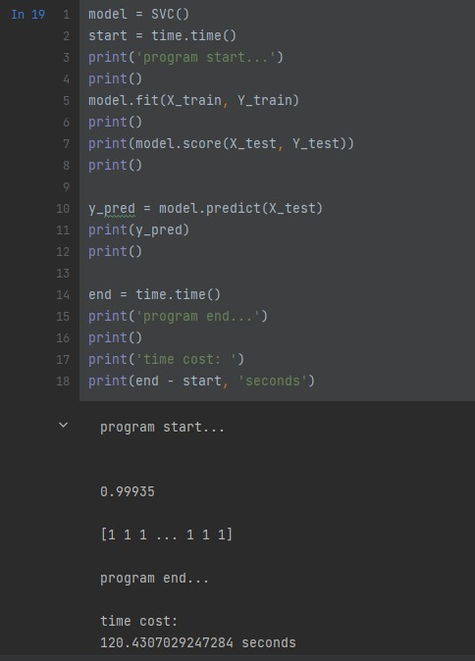

Slide 26
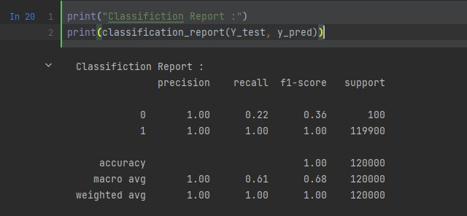

Slide 27
Title and Content Layout with Chart

Slide 28
Two Content Layout with Table
First bullet point here
Second bullet point here
Third bullet point here
Class | Group 1 | Group 2
Class 1 | 82 | 95
Class 2 | 76 | 88
Class 3 | 84 | 90

Slide 29
Two Content Layout with SmartArt
First bullet point here
Second bullet point here
Third bullet point here
Task 1
Task 2
Task 3

Slide 30
Add a Slide Title - 1

Slide 31
Add a Slide Title - 2

Slide 32
Add a Slide Title - 3

Slide 34
Add a Slide Title - 4

Slide 35
Add a Slide Title - 5

